Slide 1
Design Document
PICCIRILLO LUCA
ZAMPOGNA GIAN LUCA
ZINI EDOARDO

Slide 2
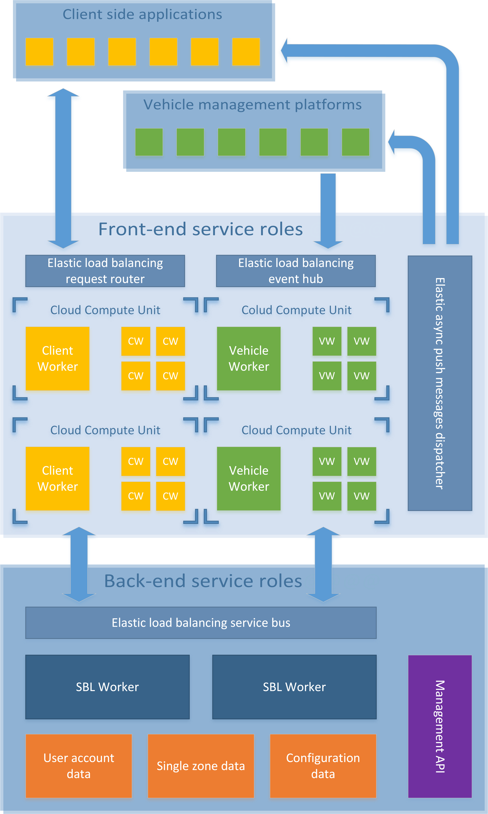
Architecture
Cloud oriented
Multi tier
Distributed

Slide 3
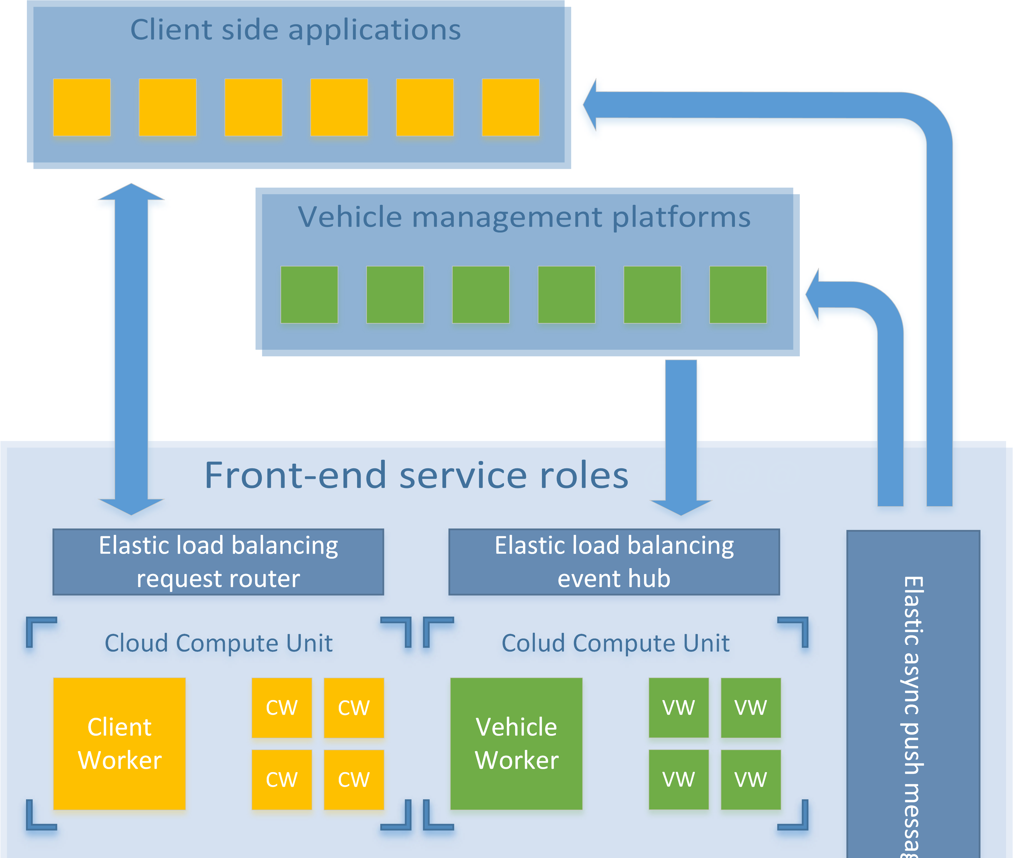

Slide 4
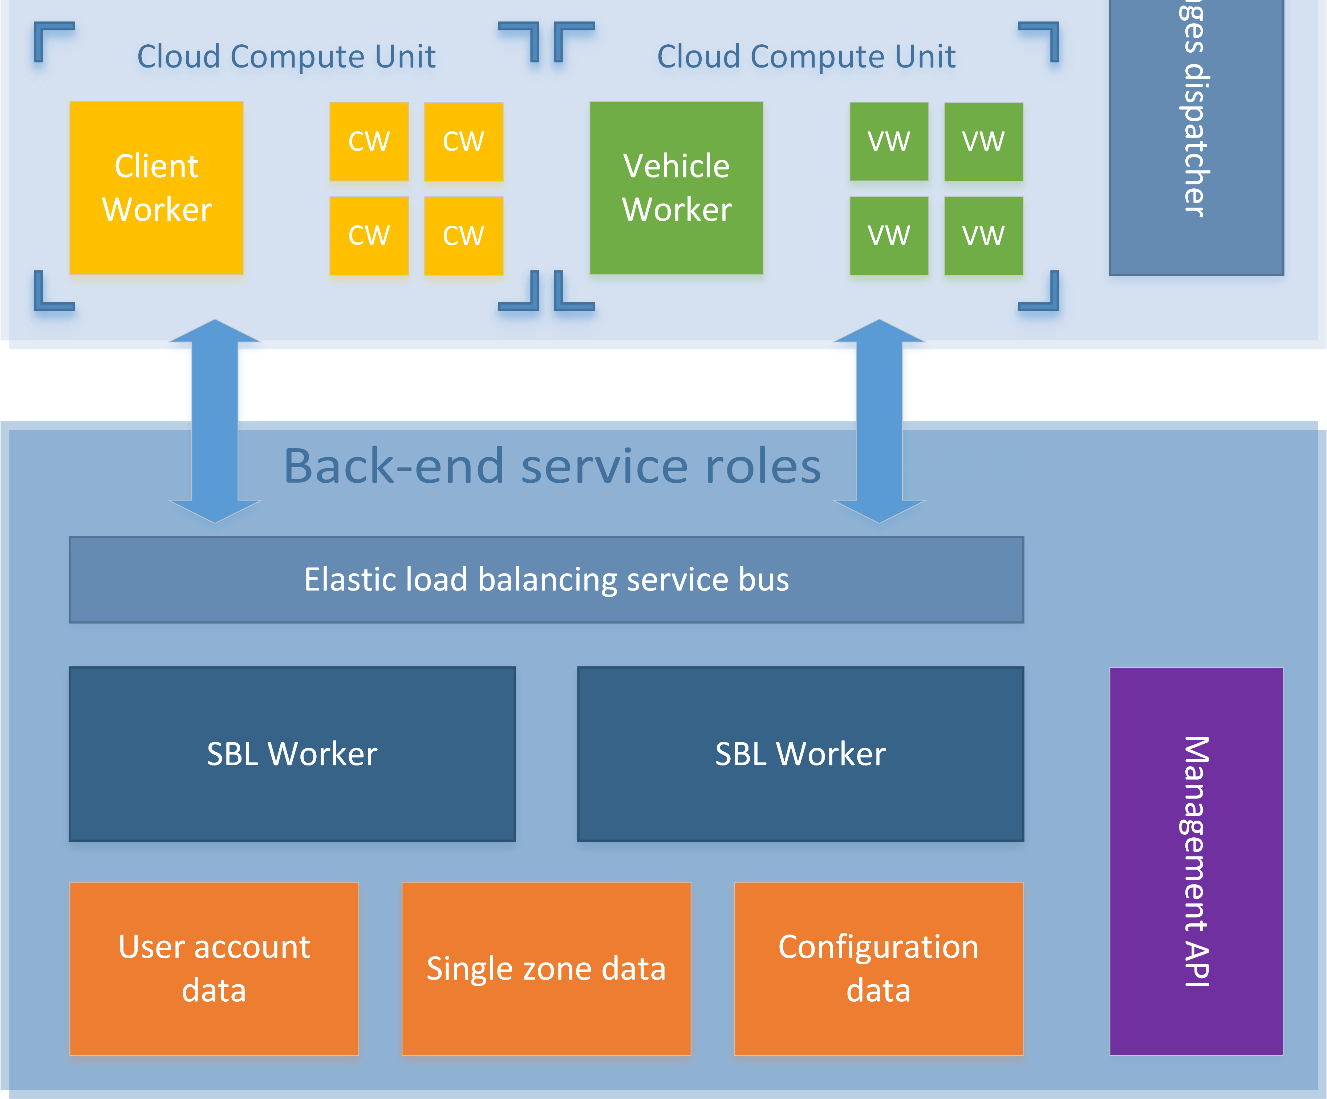

Slide 5
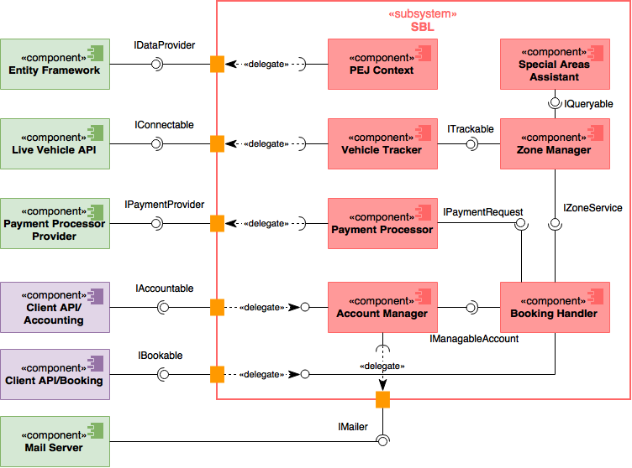
Component: Service Business Logic

Slide 6
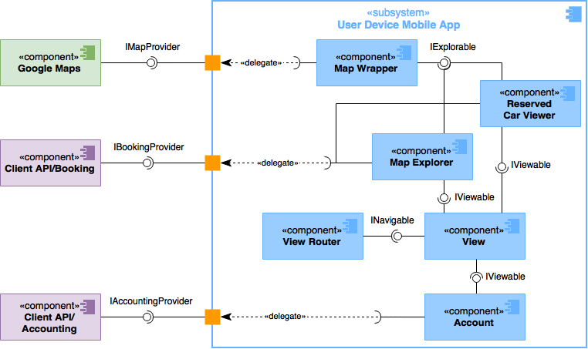
Component: User Device Mobile App

Slide 7
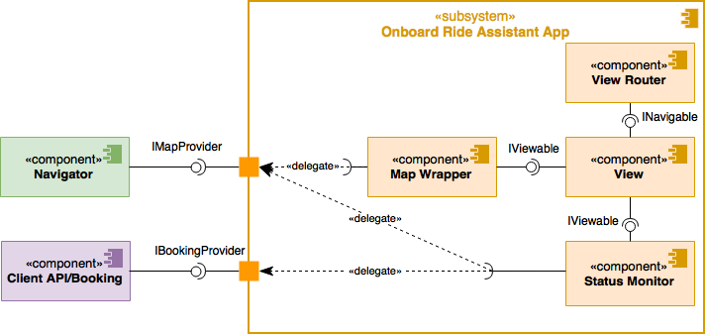
Component: Onboard Ride Assistant

Slide 8
Deployment

Slide 9
Sequence: Car Unlocking

Slide 10
Sequence: Ride

Slide 11
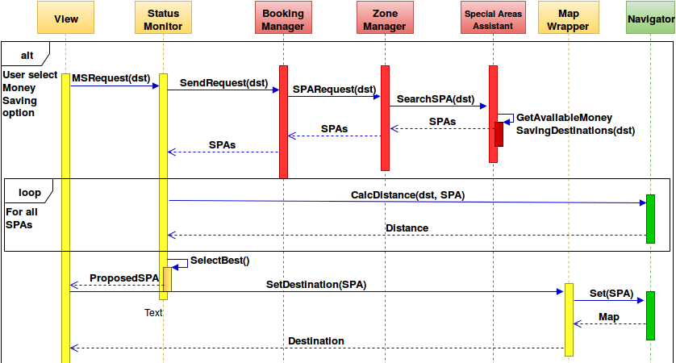
Sequence: Money Saving option

Slide 12
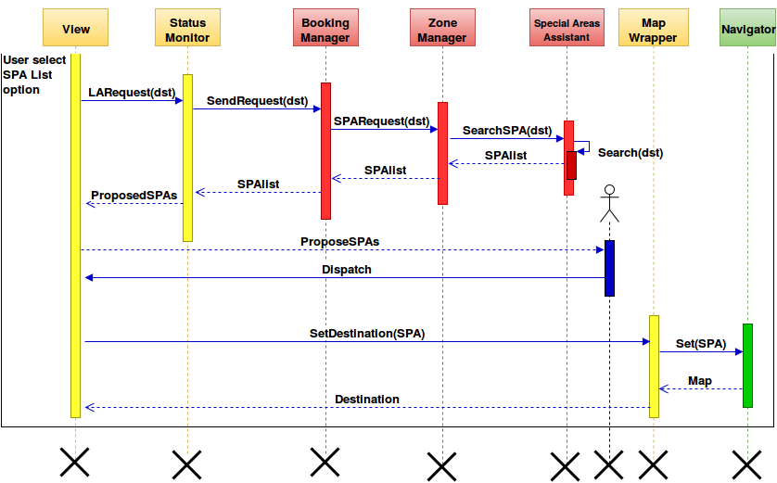
Sequence: list of Special Parking Areas

Slide 13
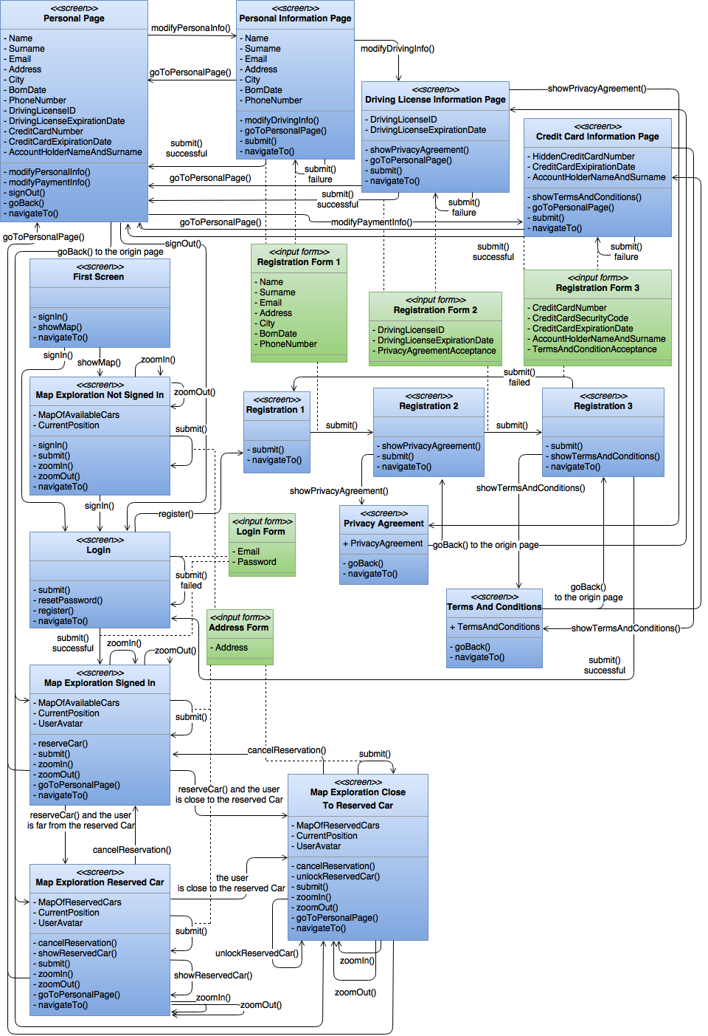
UX: User Device Mobile App

Slide 14
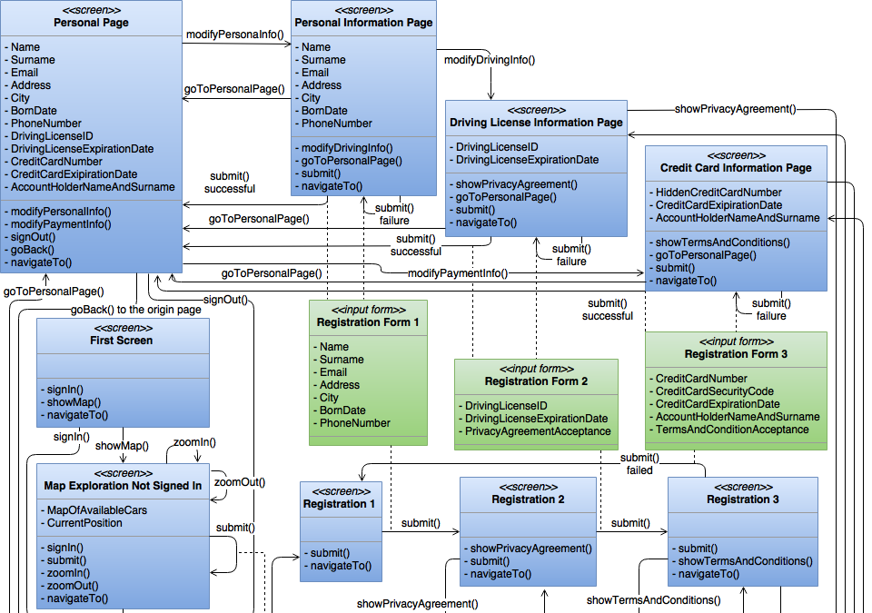

Slide 15
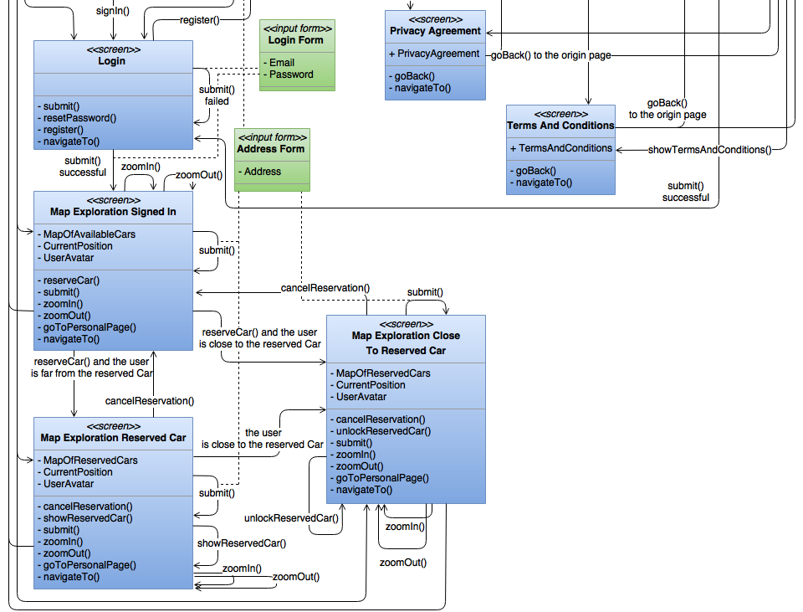

Slide 16
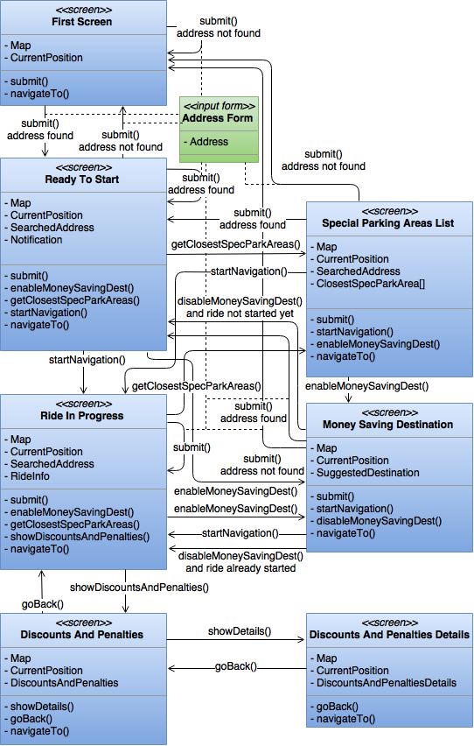
UX: Onboard Ride Assistant

